Slide 1

Specialization
Dotnet Core 5.0, ASP.Net Core
C# 9.0, WPF 4.5 .2 with Blend
ASP.Net MVC 6.0 & Micro services
WCF 4.5.1, Web API, WF 4.5.1
Python & R, BOTO3, Python with ML
DevOps, GIT, Jenkins, Docker
Django, Flask, Python Network Automation
UML 2 & OOAD, DDD, OpenAPI /swagger
HTML 5, CSS 3, SASS, Bootstrap
65 .Net Design Patterns
ES 6, Jquery 3.x,,D3.js
Aurelia, Post CSS, Gatsby, AMD
Typescript, Angular 11 & Material design
Haxe , Vue js, Oracle Jet, Open UI 5
Metal js, React & Redux , Mobx
Ext JS 6, Backbone ,Kendo UI,
Node js, Mongo DB,JSON,YAML
Mocha, Jasmine,Protractor, Karma
GIT,Docker, Webpack, Grunt, Gulp,
Python 3.9.x
Dr. D.S.R.Murthy M.Tech (IT)
Software Architect & Corporate Trainer
Experience : 30 years

Slide 2

GOOD MORNING
DSR Murthy
Notes:
Create work folder in C drive then, npm install @angular/cli
Set path : c:\work\node_modules\bin
C:\work> ng new myapp
c:\work> cd myapp
C:\work>ng serve
(open browser and type localhost:4200)

Slide 3
Advanced Python 3.9 topics
Lambda functions, (map,reduce,filter)
Iterators,decorators,generators
Debugging,profiling,memory management,optimization
Design patterns and anti-patterns with OOPs
Multi-threading and multi-processing with async/await
Context manager and working with CSV,JSON data
Working with Pickle
Testing in python (Unit & performance with pytest , locust)
Working with fork, sys, subprocess
Fast API with SqlAlchemy ORM and Dependency injection
Memory management and memory leaks in python
Python with C language integration
Data Manipulation with pandas, numpy and matlpotlib
Performance and Optimization with python
20 tips in python (Best practices)
DSR Murthy

Slide 4
Python 3.9
“Python” or “CPython” is written in C/C++
“Jython” is written in Java for the JVM
“IronPython” is written in C# for the .Net environment
DSR Murthy

Slide 5
Python Versions
Python Version Release date:
Python v0.1.0 (The First Edition) - 1990
Python v0.9.5 (Macintosh support) - 1992
….
Python v2.0.0 (Added list comprehensions) - 16th Oct’2000
Python v2.7.0 - 3rd Jul’2010
Python v3.0.0 - 3rd Dec’2008
Python v3.6.6 - Jun’2018
Python v3.7.0 - Jun’2018
Python v3.7.5 - Jan2019
Python v3.8 - Aug 2020
Python V3.9.2 - Jan 2021
DSR Murthy

Slide 6
Python 3.9
Python is easy to learn, highly readable, and simple to use
Python programming is platform independent (mac/windows/lynux)
Python is one of the preferred programming languages for working in Test Automation, Web Scraping, Data Analytics, and Machine Learning domains
Modules:
pandas, numpy ,scipy ,scikit-learn , matplotlib, tensorflow, seaborn, beautifulsoup……
DSR Murthy

Slide 7
Why Use Python?
Python 3.9
Python is object-oriented
Python supports polymorphism, operation overloading, and multiple inheritance
It's free (open source)
Online Python community is huge
It's portable – Supported on mac , windows and Linux
It's powerful
Dynamic typing
Built-in types and tools
Third party utilities (e.g. Numeric, NumPy, SciPy)
Automatic memory management
DSR Murthy

Slide 8
Python Features
Code quality - Highly readable, reusable and maintainable
Developer productivity (Dynamically typed and smaller code)
Code Portability – interpreter executes on different platforms(mac/unix/windows)
Built-in and external libraries
Component integration
Allows to load C/C++ libraries
Integration with java and .net components , COM/Silverlight, interface with USB devices and serial ports, exchange data over network like SOAP, XML-RPC
Free to use, modify and re-distribute
Data science and machine learning supporting modules
Administer Azure and AWS cloud
DSR Murthy

Slide 9
Python Programming Domains
Web application development
(Django, Flask, CherryPy and FastAPI)
Scientific and numeric computing (Data science and machine learning) - NumPy, SciPy, Pandas, matplotlib and Ipython
GUI programming (GUI and Image processing applications) .
Python is propelling many 3D animation software like 3ds Max, Blender, Cinema 4D, Houdini, and Maya.
DSR Murthy

Slide 10
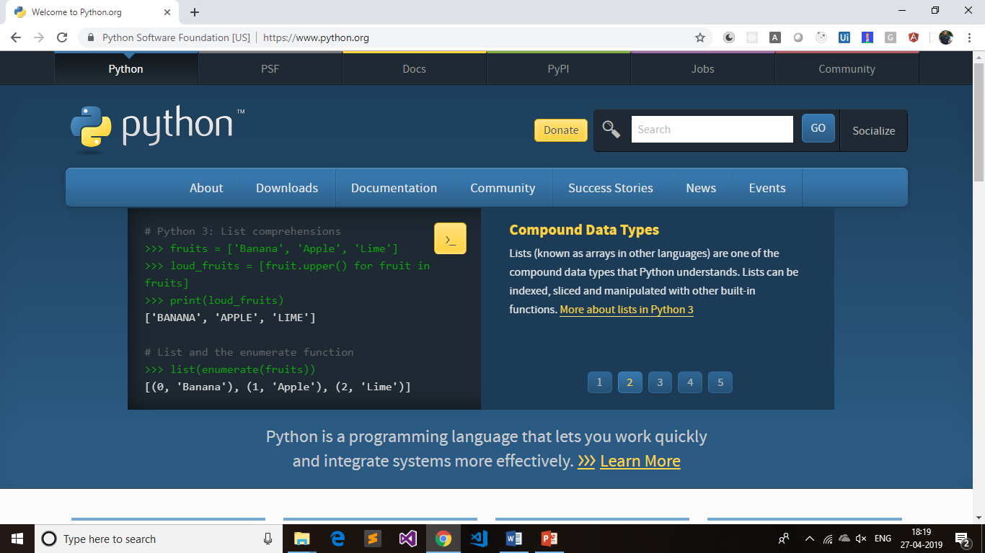
Python 3.9
DSR Murthy

Slide 11
Python 3.9
How To Get Python Running On Your System?
Visit https://www.python.org/downloads/ and click Download Python 3.9.2
RC on Computer in explorer → Properties → Advanced System setting → Click Environment Variables button → Edit Path → add xxxxxx;d:\python3.9.2
Open CMD → type Python → print(“hello Python”) → quit() to exit or CTRL+z
DSR Murthy

Slide 12
Python 3.9
$ python --version
$ pip --version
To upgrade pip tool to latest version:
$ python –m pip install - -update pip
DSR Murthy

Slide 13
Python 3.9
Virtual Environment setup:
The venv module provides support for creating lightweight “virtual environment”.
Each virtual environment has its own Python binary
which matches the version of the binary that was used to create this environment and can have its own independent set of installed Python packages in its site directories.
It allows us to publish the package/app easily to git/production with dependent modules and python runtime version.
DSR Murthy

Slide 14
Virtual environment with venv
d:\>python –m venv python-training
d:\>cd python-training
- observe venv folder with scripts and lib to store site-packages.
- in scripts folder, observe activate.bat and deactivate.bat
d:\python-training>./venv/scripts/activate.bat (venv)d:\python-training\venv\scripts> cd.. & cd..
(venv)d:\python-training>pip install requests
Create requirements.txt and add package entries & latter use
>pip install requirements.txt
DSR Murthy

Slide 15
Virtual environment with virtualenv
virtualenv is a tool to create isolated Python environments.
$ pip install virtualenv
$ virtualenv --version
Create a virtual environment for a project:
$ cd python-training
$ virtualenv venv
Python interpreter of your choice (like python2.7).
$ virtualenv -p /usr/bin/python2.7 venv
c:\Users\SomeUser\project_folder> venv\Scripts\activate
Install packages : pip install requests
DSR Murthy

Slide 16
Virtual environment with pipenv
Pipenv is a dependency manager for Python projects.
It is like Node.js’ npm and nuget for .net
Pipenv is recommended as it’s a higher-level tool
that simplifies dependency management.
$ pip install pipenv
$ cd python-training
$ pipenv shell (this activates the shell)
$ pipenv install requests
DSR Murthy

Slide 17
Virtual environment with pipenv
pipenv will install the Requests library and create a Pipfile in project’s directory.
The pipfile is used to track which dependencies of project to re-install them when we share project with others.
import requests
response = requests.get('https://httpbin.org/ip')
print('Your IP is {0}'.format(response.json()['origin']))
Run the script using pipenv run:
$ pipenv run python main.py
DSR Murthy

Slide 18
Development Environment (IDE’s)
1. PyDev with Eclipse
2. Spider (Comes with Anaconda)
3. Visual Studio Code
4. Vim
5. TextMate
6. Gedit
7. Idle
8. NotePad++ (Windows)
9.BlueFish (Linux)
10.PyCharm (Licensed)
DSR Murthy

Slide 19
Python 3.9
IDLE Editor:
From the “Start” menu, open “All Programs” and select “Python 3.9”.
Click on the “IDLE (Python GUI)” link to launch the editor.
Once the IDLE window appears, press CTRL+N to create a new file. Then, name it “hello.py” while saving using the CTRL+S. Write below code
print("Hello, World!")
Save the file and go to [Run >> Run Module] or press F5 to execute your first Python script.
DSR Murthy

Slide 20
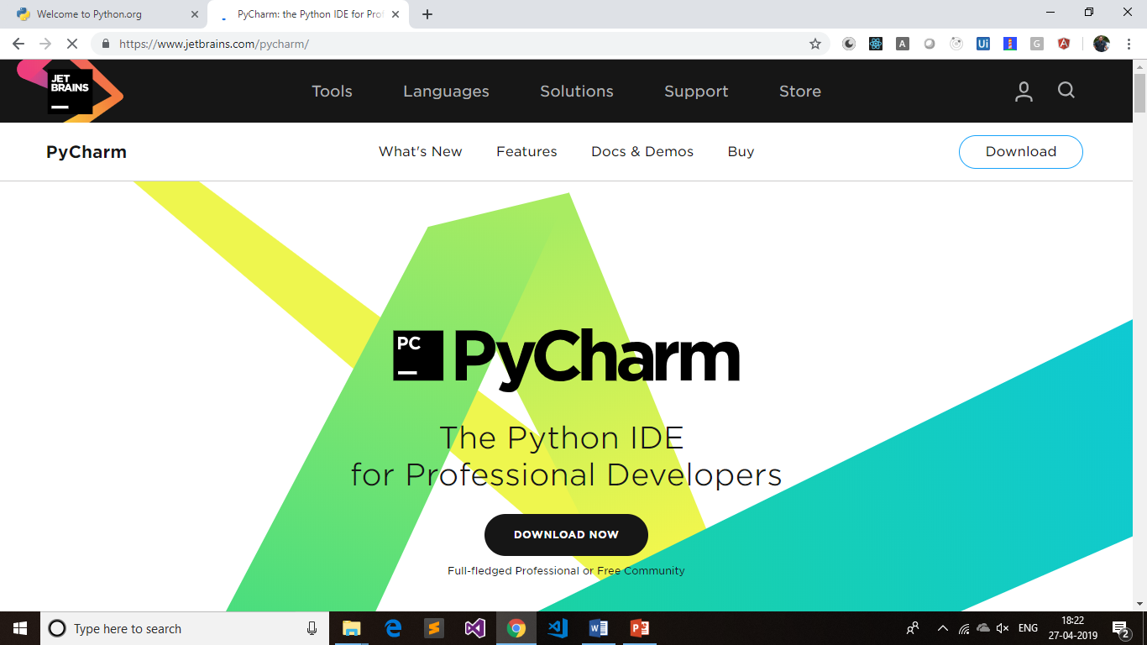
Python 3.9
DSR Murthy

Slide 21
Pip Installation
Download get-pip.py to a folder on your computer.
Open a command prompt and navigate to the folder containing get-pip.py.
Run the following command: python get-pip.py
Pip is now installed!
Verify that Pip was installed correctly by opening a command prompt :
C:\>pip –V
C:\> pip help
C:\>pip install numpy scipy scikit-learn
DSR Murthy

Slide 22

Anaconda Installtion
DSR Murthy

Slide 23
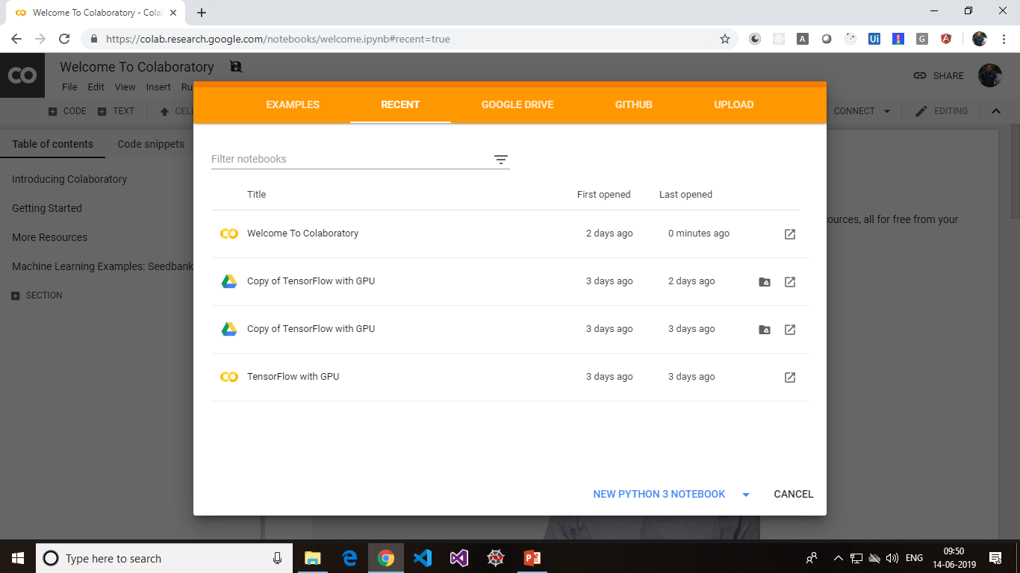
Python 3.9
https://colab.research.google.com/notebooks/welcome.ipynb#recent=true
DSR Murthy

Slide 24
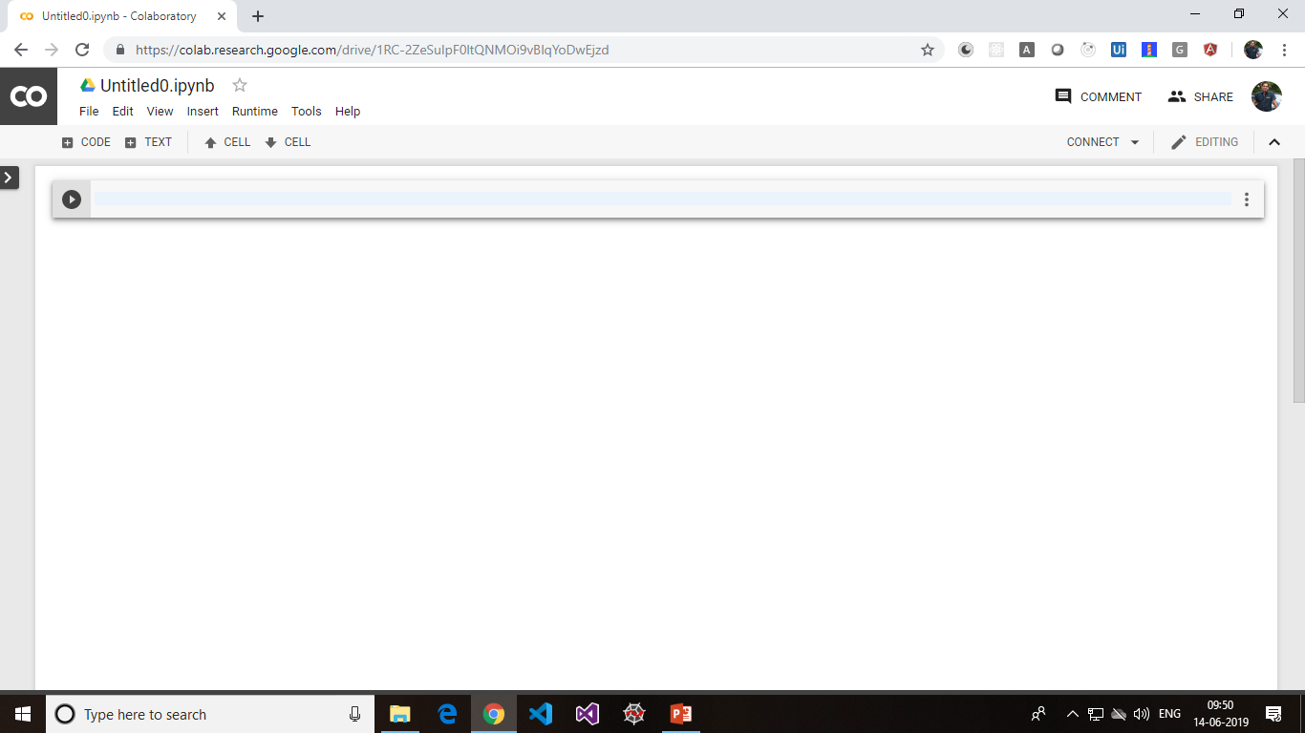
Python 3.9
https://colab.research.google.com/notebooks/welcome.ipynb#recent=true
DSR Murthy

Slide 25
Running Python
Python is an interpreter. The interpreter reads other Python programs and commands, and executes them.
Python programs are compiled automatically before being scanned into the interpreter.
C:\> python
>>>
# After a short message, the >>> symbol will appear. This signals the start of a Python interpreter's command line
DSR Murthy

